Slide 1
Front End Engineering-I Project
Team Details:
Mr. Aman Kumar: 2310991770
Ms. Amisha Pundir: 2310991771
Ms. Amrit Kaur: 2310991772
Faculty Coordinator: Mr. Ratan Deep Aneja
:
Chitkara University Institute of Engineering and Technology,
Chitkara University, Punjab

Slide 2
Table of Contents
Introduction
Problem Statement
Technical Details
Key Features
Project Highlights
Bonus Feature(optional)
Conclusion
References/Links used

Slide 3
Introduction
In the past few years, the art of food blogging has evolved into a vibrant and competitive culture, a space where passionate foodies share not only recipes but also their personal narratives and culinary adventures. Our project embarks on the delightful challenge of not just creating another food blog but crafting an immersive experience that resonates with the ever-growing community of food enthusiasts. From sizzling recipes to captivating restaurant reviews, we aspire to carve a niche in the online food landscape, guided by a commitment to excellence, authenticity, and the art of visually tantalizing storytelling. Join us as we unravel the secrets to establishing and sustaining a thriving food blog in this era of culinary exploration. Let the culinary odyssey begin! 🍽️✨
TEAM MEMBERS
1:AMAN KUMAR
2:AMISHA PUNDIR
3:AMRIT KAUR

Slide 4
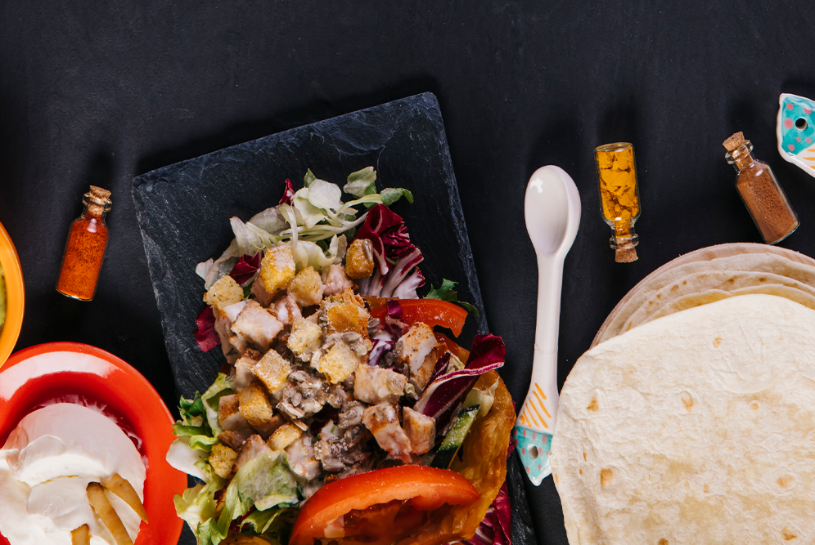
Problem Statement
Food blogging has become a very popular hobby in the last two to three years. Food blogs cover recipes, restaurant reviews, and every other aspect of the foodie world, and are often accompanied by gorgeous food photography.
The project aims to address the challenge of establishing and maintaining a successful food blog page in an increasingly competitive online food culture.

Slide 5




Technical Details
HTML (HyperText Markup Language) : It is the code that is used to structure a web page and its content. For example, content could be structured within a set of paragraphs, a list of bulleted points, or using images and data tables.
CSS (Cascading Style Sheets) : It is used to style and layout web pages — for example, to alter the font, color, size, and spacing of your content, split it into multiple columns, or add animations and other decorative features.
JAVASCRIPT
Here, JavaScript code that handles a menu bar click event and uses the ScrollReveal library for adding scroll animations to various elements on your webpage. The code toggles a class on the menu bar and the navigation bar to show/hide the menu, and it reveals different elements with scroll animations

Slide 6
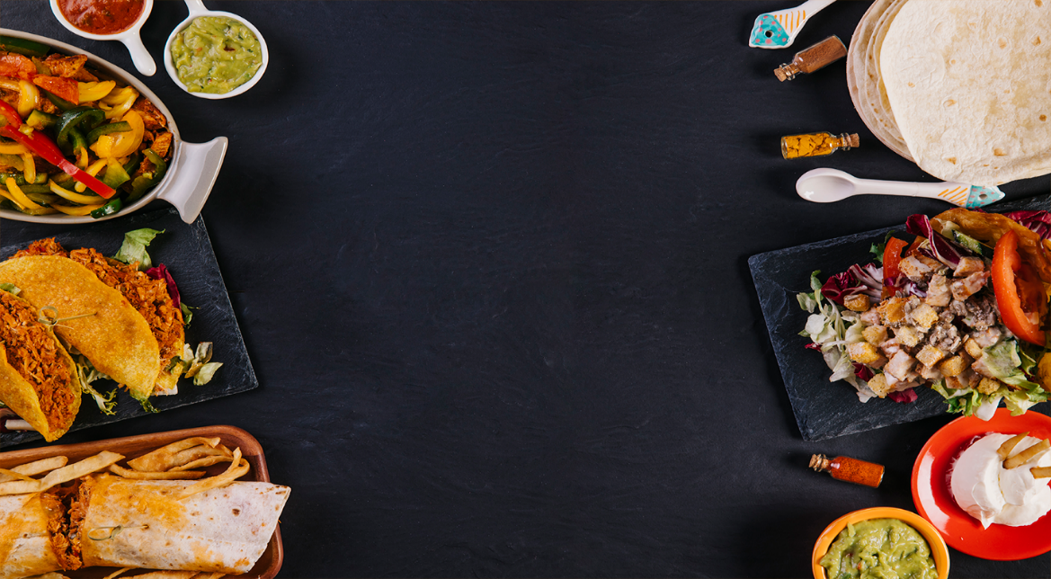
Key Features
A clean, responsive design that works well on both desktop and mobile devices.
Easy navigation with clear categories and search functionality.
We have given a unique branding name
Image optimization tools to ensure fast-loading

Slide 7
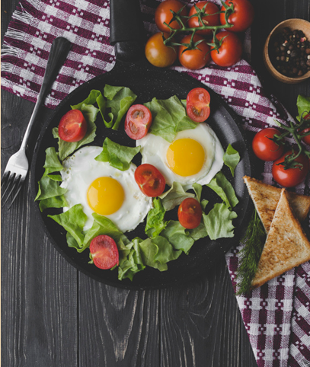
Project Highlights
Sharing Delicious Recipes: Bloggers delight in sharing their favorite recipes, from mouthwatering appetizers to delectable desserts, allowing readers to give a feedback to us.
Healthy Living: Many food bloggers focus on creating nutritious and balanced recipes, promoting healthier lifestyles through mindful eating choices.
Cooking Tips and Techniques: Bloggers often share cooking tips, techniques, and hacks to help readers improve their culinary skills and become more confident in the kitchen.

Slide 8
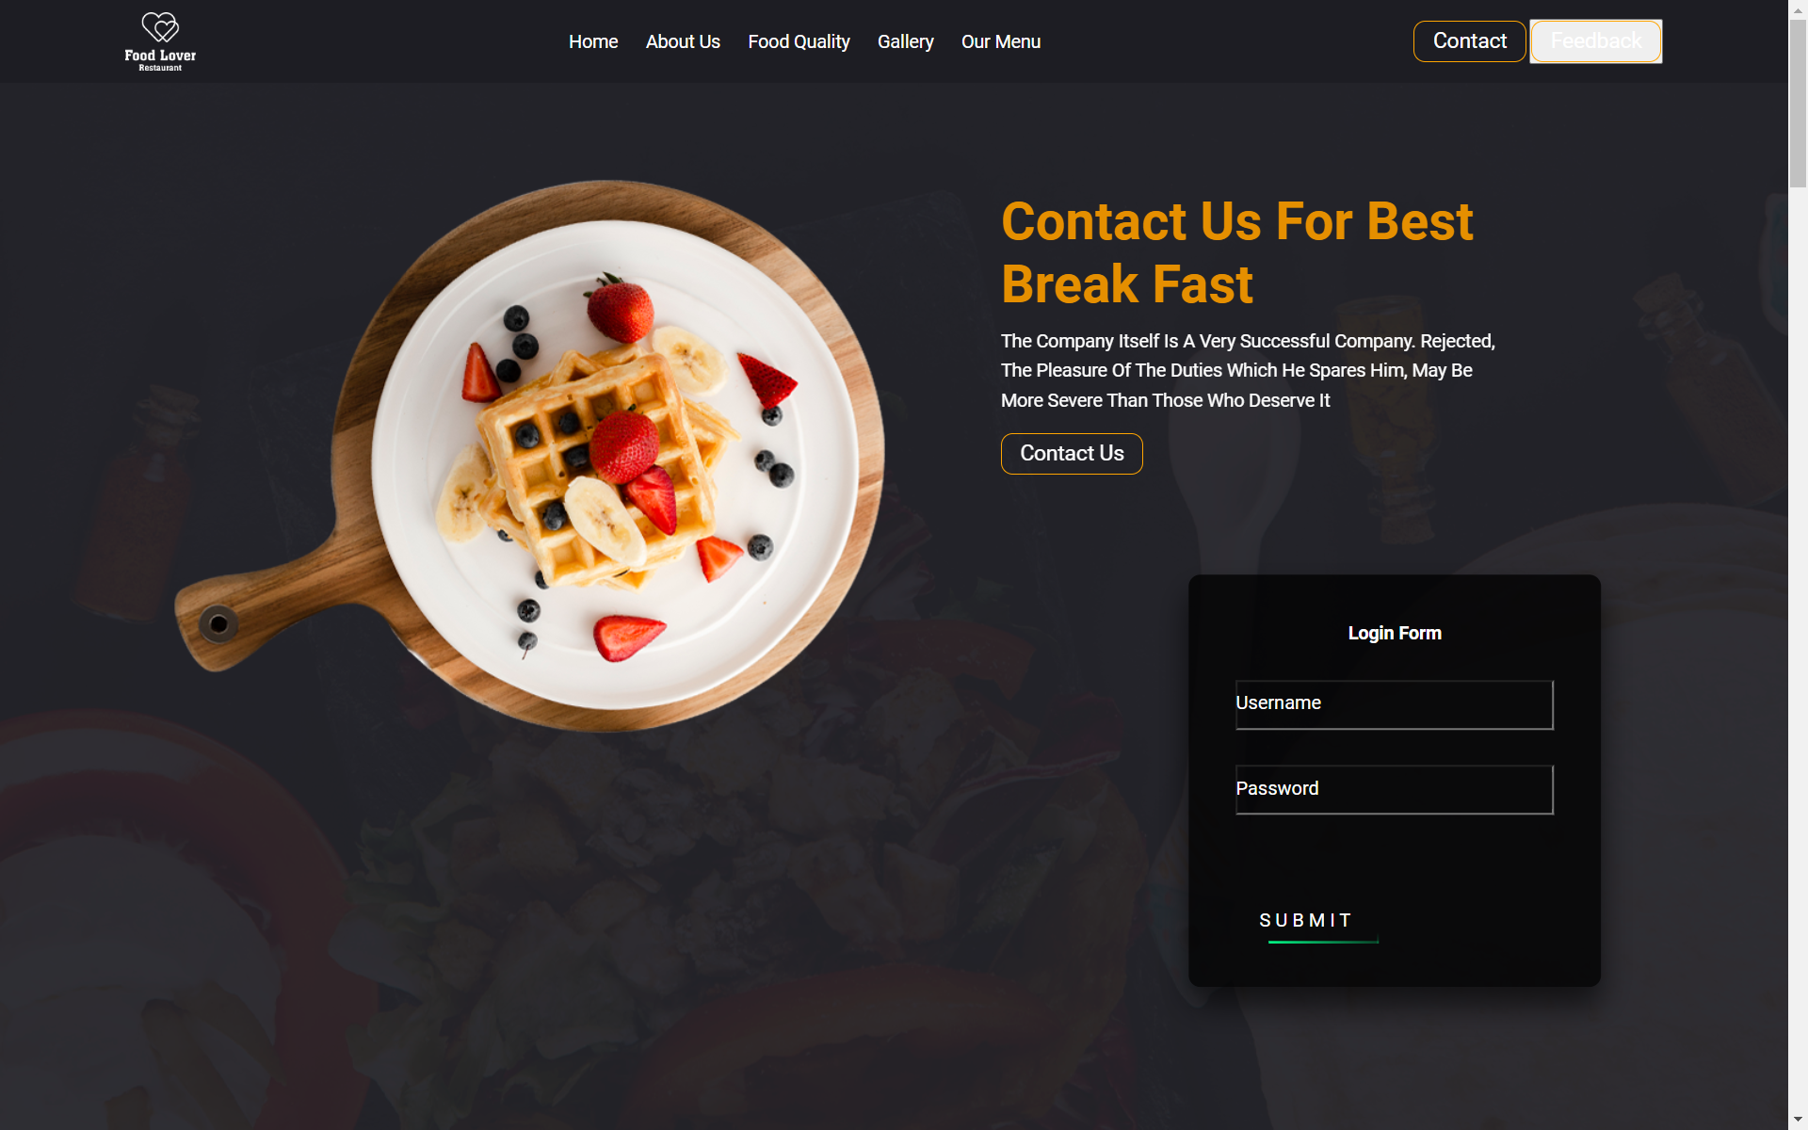
BLOG PAGE PREVIEW

Slide 9
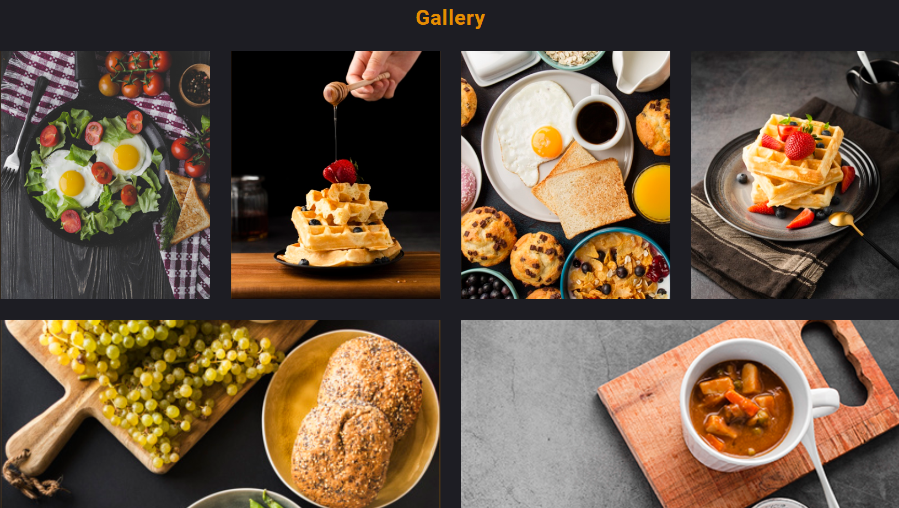
OUR GALLERY

Slide 10
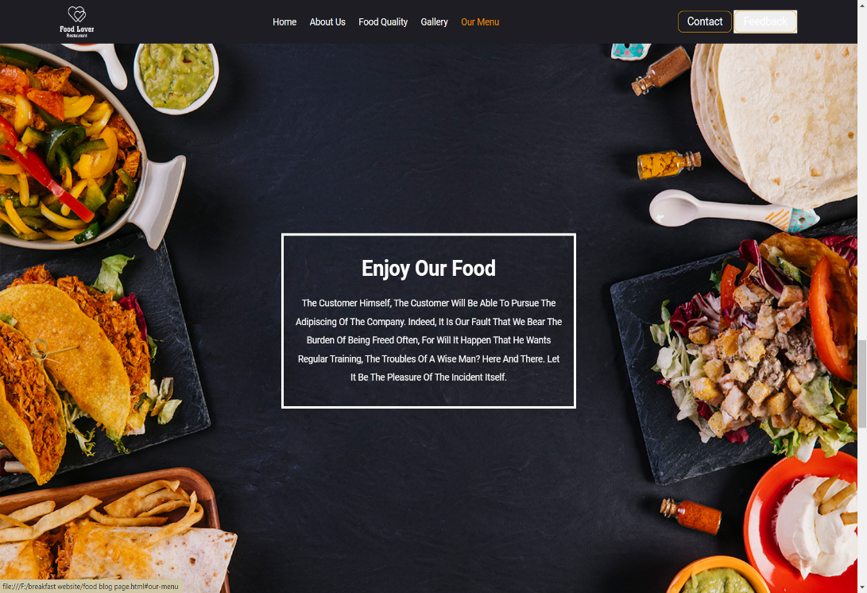
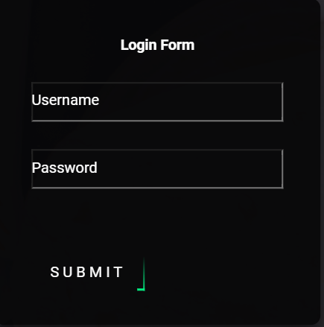
LOGIN PAGE AND OUR MESSAGE

Slide 11
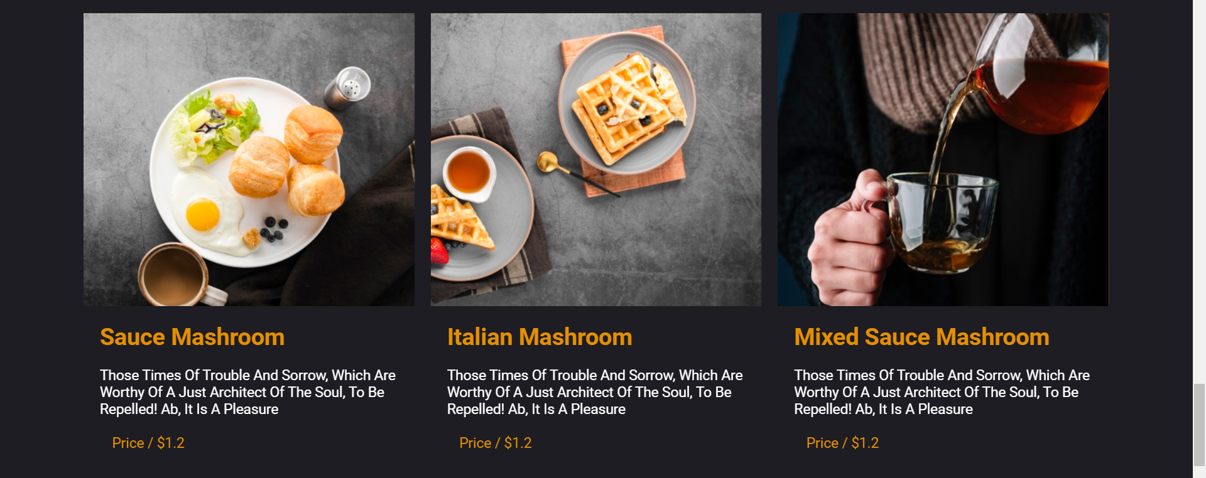
MENU PAGE

Slide 12
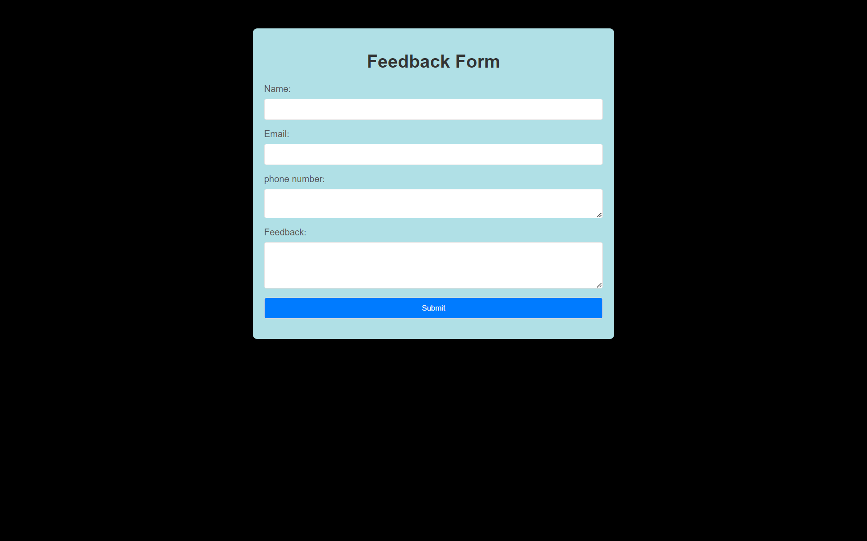
FEEDBACK FORM

Slide 13
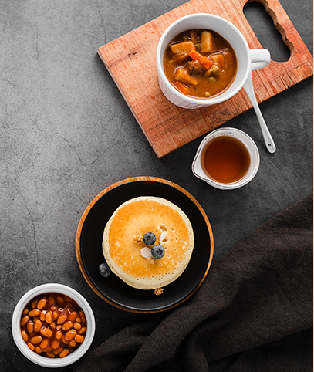
Conclusion
In conclusion, food blogging is a vibrant and dynamic niche within the digital landscape that offers both opportunities and challenges
To succeed in the world of food blogging, one must navigate through the complexities of content creation, audience engagement, and monetization while adhering to legal and ethical standards.

Slide 14
References/Links used
https://www.epicurious.com/expert-advice
https://asianfoodnetwork.com/en/recipes/cuisine/chinese/ngoh-hiang.html
https://www.epicurious.com/recipes-menus/best-cookie-recipes-chocolate-chip-raisin-peanut-butter-gallery
https://smittenkitchen.com/recipes/greek/?format=photo
https://www.101cookbooks.com/homemade-spice-blends/
https://www.closetcooking.com/20-apple-icious-recipes/
https://damndelicious.net/2020/12/18/garlic-rosemary-beef-tenderloin/
https://pinchofyum.com/winter-grain-bowl-with-balsamic-dressing
https://www.recipegirl.com/mixed-green-salad-with-honey-lemon-dressing/
https://www.sailusfood.com/kosambari-recipe-moong-dal-salad/

Slide 15


